Slide 1

UNIT - 1 : INTRODUCTION
JAIN UNIVERSITY
SCHOOL OF COMPUTER SCIENCE AND IT
DEPARTMENT OF BCA
SUB : RDBMS
SUB CODE : 16BCA3C02

Slide 2
INTRODUCTION
Database systems have become an essential component of life in modern society
Ex : bank transactions, hotel/airline reservations, grocery store purchases

Slide 3
Database : Database is a collection of related data.
Properties of Database :
A database represents some aspect of the real world - miniworld or the universe of discourse (UoD).
A database is a logically coherent collection of data with some inherent meaning.
A database is designed, built, and populated with data for a specific purpose.

Slide 4
Database Management System :
The DBMS is a general-purpose software system that facilitates the processes of defining, constructing, manipulating, and sharing databases among various users and applications.
Defining : Data types, structures, and constraints of the data to be stored in the data base.
The database definition or descriptive information is also stored by the DBMS in the form of a database catalog or dictionary it is called meta-data.

Slide 5
Database Management System (Contd…)
Constructing : Storing the data on some storage medium that is controlled by the DBMS.
Manipulating : querying, updating the database reflect changes in the mini world, and generating reports from the data.
Sharing : allows multiple users and programs to access the database simultaneously.

Slide 6
Functions provided by the DBMS includes :
Protecting the database
Hardware or software malfunction (or crashes)
security protection
Maintaining it over a long period of time

Slide 7
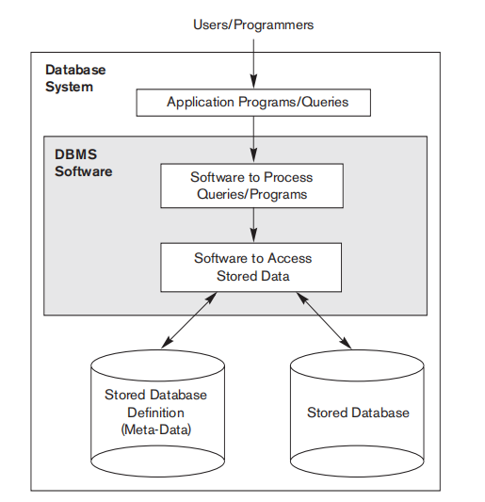
DATABASE SYSTEM:
Fig : A Simplified Database Environment

Slide 8

Example :
Fig : A database that stores student and course information.

Slide 9
Requirements Specification and Analysis:
Three phases of requirements specification and analysis :
Conceptual design: Include design interactions, experience and strategies which are documented in detail.
Logical design: Conceptual design can be expressed in a data model implemented in a commercial DBMS. (Logical relationship, constraints etc,).
Physical design: The database design is implemented, populated with actual data, and continuously maintained to reflect the state of the mini world.

Slide 10
Characteristics of the Database Approach:
Self-Describing Nature of a Database System
Insulation between Programs and Data, and Data Abstraction
Support of Multiple Views of the Data
Sharing of Data and Multiuser Transaction Processing

Slide 11
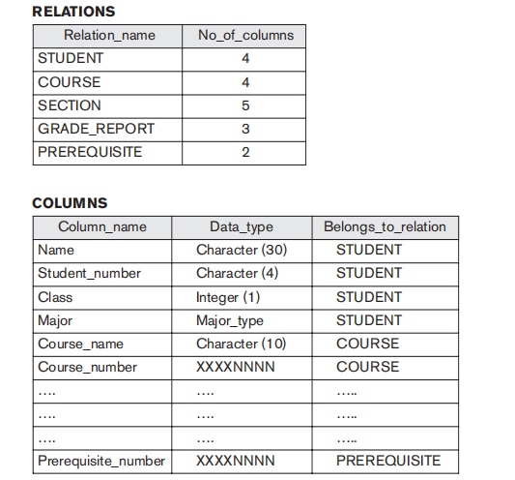
Self-Describing Nature of a Database System
Database system contains not only the database itself but also a complete definition or description of the database structure and constraints.
This definition is stored in the DBMS catalog, which contains information such as the structure of each file, the type and storage format of each data item, and various constraints on the data.
The information stored in the catalog is called meta-data, and it describes the structure of the primary database (As shown in Figure ).

Slide 12
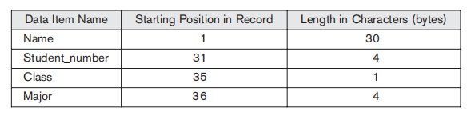
2. Insulation between Programs and Data, and Data Abstraction
The structure of data files is stored in the DBMS catalog separately from the access programs - program-data independence.
User application programs can operate on the data by invoking these operations through their names and arguments, regardless of how the operations are implemented - program-operation independence.
The characteristic that allows program-data independence and program-operation independence - data abstraction.
Fig : Internal storage format for a STUDENT record, based on the database catalog

Slide 13
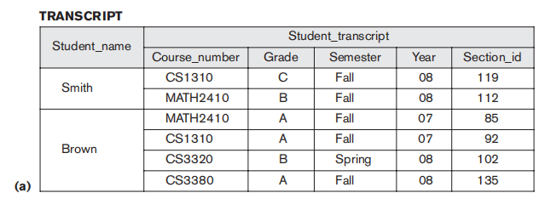
3. Support of Multiple Views of the Data :
A multiuser DBMS whose users have a variety of distinct applications must provide facilities for defining multiple views.

Slide 14
4. Sharing of Data and Multiuser Transaction Processing :
DBMS must allow multiple users to access the database at the same time.
The DBMS must include concurrency control software to ensure that several users trying to update the same data do so in a controlled manner so that the result of the updates is correct.

Slide 15
Actors on the Scene:
The people whose jobs involve the day-to-day use of a large database - actors on the scene.
They are :
Database Administrators
Database Designers
End Users
System Analysts and Application Programmers (Software Engineers)

Slide 16
1. Database Administrators
Administering resources (DB and DBMS related s/w) is the responsibility of the database administrator (DBA).
The DBA is responsible for authorizing access to the database, coordinating and monitoring its use, and acquiring software and hardware resources as needed.
The DBA is accountable for problems such as security breaches and poor system response time.

Slide 17
2. Database Designers :
They are responsible for identifying the data to be stored in the database and for choosing appropriate structures to represent and store this data.
It is the responsibility of database designers to communicate with all prospective database users in order to understand their requirements and to create a design that meets these requirements.
The final database design must be capable of supporting the requirements of all user groups.

Slide 18
3. End Users :
End users are the people whose jobs require access to the database for querying, updating, and generating reports.
The several categories of end users:
■ Casual end users : occasionally access the database.
■ Naive or parametric end users :Their main job function revolves around constantly querying and updating the database, called canned transaction.
■ Standalone users maintain personal databases by using ready-made program packages that provide easy-to-use menu-based or graphics-based interfaces.

Slide 19
4. System Analysts and Application Programmers (Software Engineers)
System analysts determine the requirements of end users, especially naive and parametric end users, and develop specifications for standard canned transactions that meet these requirements.
Application programmers implement these specifications as programs, then they test, debug, document, and maintain these canned transactions. Such analysts and programmers - Software Developers or Software Engineers.

Slide 20
Workers behind the Scene :
The people who work to maintain the database system environment but who are not actively interested in the database contents as part of their daily job - workers behind the scene .
DBMS system designers/implementers: provide the DBMS software that is at the foundation of all this!
Tool developers: design and implement software tools facilitating database system design, performance monitoring, creation of graphical user interfaces, prototyping, etc.
Operators and maintenance personnel: responsible for the day-to-day operation of the system.

Slide 21
Advantages of Using the DBMS Approach:
Controlling Redundancy
Restricting Unauthorized Access
Providing Persistent Storage for Program Objects
Providing Storage Structures for Efficient Query Processing
Providing Backup and Recovery.
Providing Multiple User Interfaces
Representing Complex Relationships Among Data
Enforcing Integrity Constraints
Permitting Inference and Actions Via Rules
Potential for enforcing standards
Reduced application development time
Flexibility to change data structures
Availability of up-to-date information
Economies of scale.

Slide 22
Database System Concepts and Architecture

Slide 23
Database System Concepts
Data abstraction generally refers to the suppression of details of data organization and storage, and the highlighting of the essential features for an improved understanding of data.
Data model—a collection of concepts that can be used to describe the structure of a database.
Categories of Data Models:
High-level or conceptual data models
low-level or physical data models
Representational (or implementation) data models

Slide 24
Categories of Data Models:
1. High-level or conceptual data models : provide concepts that are close to the way many users perceive data.
Conceptual data models use concepts such as entities, attributes, and relationships.
2. low-level or physical data models : provide concepts that describe the details of how data is stored on the computer storage media.
3. Representational (or implementation) data models which provide concepts that may be easily understood by end users. Representational data models hide many details of data storage on disk but can be implemented on a computer system directly.

Slide 25
Types of Data Models:
Hierarchical Model
Network Model
Relational Model
Object oriented Model
E-R Model.

Slide 26
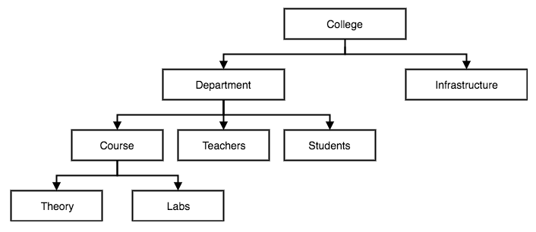
1. Hierarchical Model :
This database model organizes data into a tree-like-structure, with a single root, to which all the other data is linked.
The heirarchy starts from the Root data, and expands like a tree, adding child nodes to the parent nodes.
In this model, a child node will only have a single parent node.

Slide 27
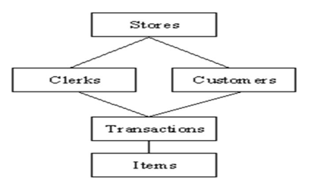
2. Network Model:
This is an extension of the Hierarchical model.
In this model data is organised more like a graph, and are allowed to have more than one parent node.
In this database model data is more related as more relationships are established in this database model. Also, as the data is more related, hence accessing the data is also easier and fast. This database model was used to map many-to-many data relationships.
This was the most widely used database model, before Relational Model was introduced.

Slide 28
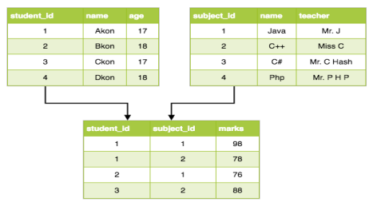
3. Relational Model :
In this model, data is organised in two-dimensional tables and the relationship is maintained by storing a common field. This model was introduced by E.F Codd in 1970.
The basic structure of data in the relational model is tables. All the information related to a particular type is stored in rows of that table.
Hence, tables are also known as relations in relational model.

Slide 29
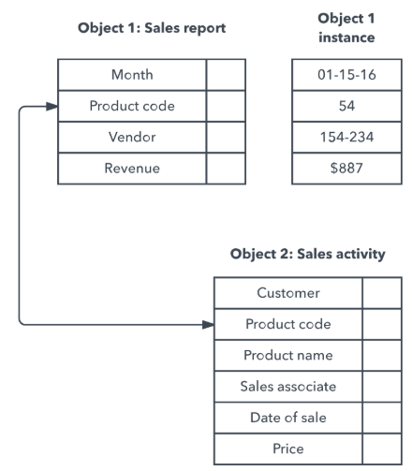
4. Object Oriented Data Model(OODM):
In the object oriented data model, both data and their relationships are contained in a single structure known as an object.
The Components of the OODM :
An object, Attributes , Classes and Inheritance

Slide 30
Schemas, Instances, and Database State

Slide 31
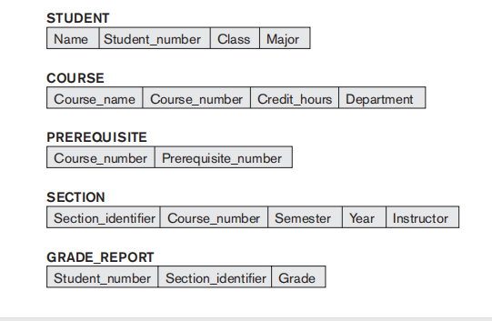
Schemas, Instances, and Database State:
Schema : The description of a database is called the database schema, which is specified during database design and is not expected to change frequently. Sometimes it is called as intension.
Schema Diagram A displayed schema is called a schema diagram.

Slide 32
Schema Construct: structure of each record type but not the actual instances of records.
Ex : each object in the schema—such as STUDENT or COURSE
Snapshot / Database State: The data in the database at a particular moment in time is called a database state or snapshot. Sometimes it is called as extension.
Schema Evolution: It is the ability of a database system to respond to changes in the real world by allowing the schema to evolve.

Slide 33
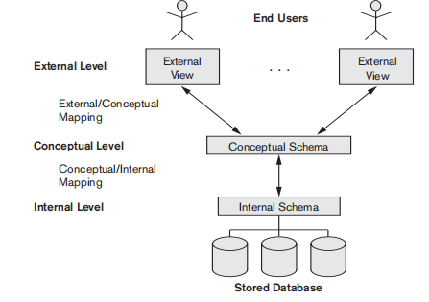
Three-Schema Architecture:
The three levels are :
The internal level
The Conceptual level
The external or
view level

Slide 34
Data Independence :
It is defined as the capacity to change the schema at one level of a database system without having to change the schema at the next higher level.
Types:
Logical data independence : is the capacity to change the conceptual schema without having to change external schemas or application programs.
Physical data independence : is the capacity to change the internal schema without having to change the conceptual schema

Slide 35
Database languages:
Types of Database Languages are:
Data Definition Language (DDL)
Storage Definition Language (SDL)
View Definition Language (VDL)
Data Manipulation Language (DML)

Slide 36
Data Definition Language (DDL): is used by the DBA and by database designers to define schemas.
Storage Definition Language (SDL): is used to specify the internal schema. The mappings between the two schemas may be specified in either one of these languages.
View Definition Language (VDL): To specify user views and their mappings to the conceptual schema, but in most DBMSs the DDL is used to define both conceptual and external schemas. In relational DBMSs, SQL is used in the role of VDL to define user or application views as results of predefined queries

Slide 37
4. Data Manipulation Language (DML): Once the database schemas are compiled and the database is populated with data, users must have some means to manipulate the database. Typical manipulations include retrieval, insertion, deletion, and modification of the data. The DBMS provides a set of operations or a language called the (DML) for these purposes.
Types:
High-Level Or Nonprocedural
A Lowlevel Or Procedural

Slide 38
High-Level Or Nonprocedural DML
DML can be used on its own to specify complex database operations concisely.
Many DBMSs allow high-level DML statements either to be entered interactively from a display monitor or terminal or to be embedded in a general-purpose programming language.
In the latter case, DML statements must be identified within the program so that they can be extracted by a precompiler and processed by the DBMS.

Slide 39
b. Lowlevel Or Procedural DML :
It must be embedded in a general-purpose programming language. This type of DML typically retrieves individual records or objects from the database and processes each separately , hence some times it is called as record – at – a –time.
Ex: DL/1, a DML is a low-level DML that uses commands such as GET UNIQUE, GET NEXT, or GET NEXT WITHIN PARENT to navigate from record to record within a hierarchy of records in the database.

Slide 40
DBMS Interfaces:
Types :
Menu-Based Interfaces for Web Clients or Browsing
Forms-Based Interfaces
Graphical User Interfaces
Natural Language Interfaces.
Speech Input and Output.
Interfaces for Parametric Users.
Interfaces for the DBA.

Slide 41
Data Modelling Using the Entity-Relationship (ER) Model

Slide 42
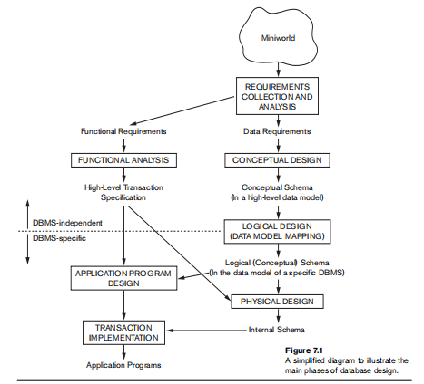
Main Phases Of Database Design

Slide 43
Entities and Attributes
Entity : is a thing in the real world with an independent existence. An entity may be an object with a physical existence (a particular person, car, house, or employee) or it may be an object with a conceptual existence (a job, or a university course).
An entity is represented as rectangle in an ER diagram.
Notation :
Example :
Student

Slide 44
Attribute : The properties that describe entity.
For example, an EMPLOYEE entity may be described by the employee’s name, age, address, salary, and job.
An entity is represented as oval in an ER diagram.
Types :
a.Simple versus Composite, Notation
b.SingleValued versus Multivalued, &
c.Stored versus Derived.
d.Null Value for an Attribute. Example
e.Complex attribute.
Name

Slide 45

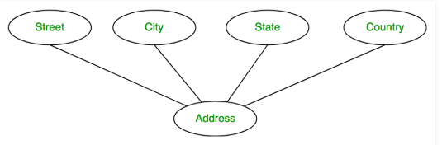
Types of Attributes
1. Composite versus Simple (Atomic) Attributes :
Composite attributes : It can be divided into smaller subparts.
Simple Or Atomic Attributes: Simple attributes are atomic values, which cannot be divided further.
For example, a student's phone number is an atomic value of 10 digits.
Notation Example

Slide 46


2. Single-Valued versus Multivalued Attributes.
Single-Valued : The attributes have a single value for a particular entity; such attributes are called single-valued.
For example, Age is a single-valued attribute of a person.
Multivalued : A multivalued attribute may have a multiple value for a particular entity
For example, the degree of a person.
Notation Example

Slide 47


3. Stored versus Derived Attributes
Stored attribute : is an attribute that cannot be derived from other attributes.
Ex: Date of Birth
Derived Attributes : is an attribute that can be obtained using another stored attributes.
Ex : Age attribute can be derived from DOB attribute.
Notation Example

Slide 48
4. Null Values for an attribute :
It is a value to be considered when a particular entity may not have an applicable value for an attribute.
For example, the Apartment_number attribute of an address applies only to addresses that are in apartment buildings and not to other types of residences, such as single-family homes.
The unknown category of NULL can be further classified into two cases.
The first case arises when it is known that the attribute value exists but is missing—for instance, if the Height attribute of a person is listed as NULL.
The second case arises when it is not known whether the attribute value exists—for example, if the Home_phone attribute of a person is NULL.

Slide 49

5. Complex Attributes:
Combination of a composite and multivalued attributes. It can be represented as arbitrary nesting by grouping components of a composite attribute between parentheses () and separating the components with commas, and by displaying multivalued attributes between braces { }. Such attributes are called complex attributes.

Slide 50
Entity Types, Entity Sets, Keys, and Value Sets

Slide 51
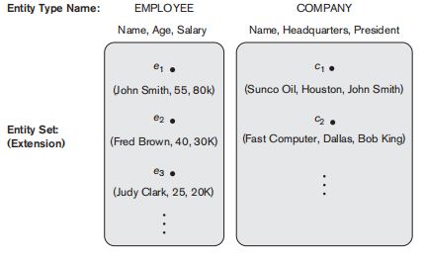
Entity Types: Defines a collection (or set) of entities that have the same attributes.
Example:shows two entity types EMPLOYEE and COMPANY.
Entity Sets: The collection of all entities of a particular entity type in the database at any point in time is called an entity set.

Slide 52

Key Attributes of an Entity Type: An entity type usually has one or more attributes whose values are distinct for each individual entity in the entity set. Such an attribute is called a key attribute, and its values can be used to identify each entity uniquely.
Ex : USN, SSN, Mobile Number etc.
Weak Entity Type : Entity types that do not have key attributes of their own are called weak entity type.
Notation Example
Dependent

Slide 53
Relationship Types, Relationship Sets, Roles, and Structural Constraints

Slide 54
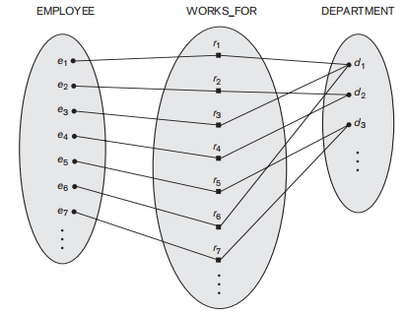
Relationship Type : R among n entity types E1, E2, ..., En defines a set of association
Relationship Set : Entities from the entity types.
Relationship Instances : The relationship set R is a set of relationship instances ri, where each ri associates n individual entities (e1, e2, ..., en), and each entity ej in ri is a member of entity set Ej.
Note:
In ER diagrams, relationship types are displayed as diamond-shaped boxes, which are connected by straight lines to the rectangular boxes representing the participating entity types. The relationship name is displayed in the diamond-shaped box

Slide 55
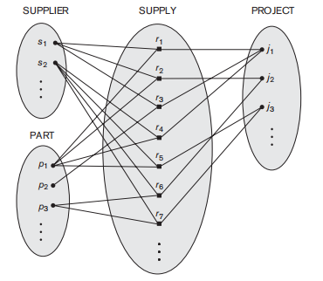
Relationship Degree, Role Names, and Recursive Relationships
Degree of a Relationship Type: The degree of a relationship type is the number of participating entity types.
The WORKS_FOR relationship is of degree two. A relationship type of degree two is called binary, and one of degree three is called ternary.
An example of a ternary relationship is SUPPLY, shown in below Fig, where each relationship instance ri associates three entities—a supplier s, a part p,and a project j—whenever s supplies part p to project j.

Slide 56
Constraints on Binary Relationship Types
Two main types of binary relationship constraints:
cardinality ratio and
participation.
Cardinality Ratios for Binary Relationships : The cardinality ratio for a binary relationship specifies the maximum number of relationship instances that an entity can participate in.
The possible cardinality ratios for binary relationship types are :
1:1
1:N
N:1
M:N

Slide 57
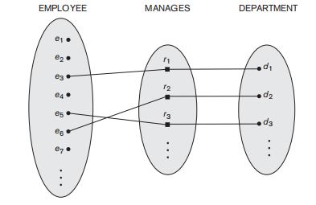
1:1 (One to One) cardinality ratio : If an entity [a record] of one entity set is associated with maximum of one entity of the other entity set, then the relationship type is said to be one-to-one.

Slide 58
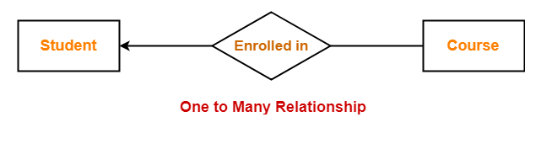
2) 1:N (One to Many) : If an entity of one entity set is associated with zero or more entities of the other entity set, then the cardinality ratio is said to be one-to-many from one side entity set to the many side entity set.

Slide 59

3) N:1 (Many to One) : An entity in set A can be associated with at most one entity in set B and an entity in set B can be associated with any number (zero or more) of entities in set A.

Slide 60
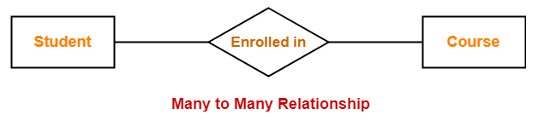
4) M:N (Many to Many) : An entity in set A can be associated with any number (zero or more) of entities in set B and an entity in set B can be associated with any number (zero or more) of entities in set A.

Slide 61
Participation Constraints and Existence Dependencies
The participation constraint specifies whether the existence of an entity depends on its being related to another entity via the relationship type.
There are two types of participation constraints—
Total Participation And
Partial Participation

Slide 62
Total participation : The participation of EMPLOYEE in WORKS_FOR is called total participation, meaning that every entity in the total set of employee entities must be related to a department entity via WORKS_FOR. Total participation is also called existence dependency.
Partial Participaion :, meaning that some or part of the set of employee entities are related to some entity
The cardinality ratio and participation constraints together, is called structural constraints of a relationship type.
In ER diagrams, total participation (or existence dependency) is displayed as a double line connecting the participating entity type to the relationship, whereas partial participation is represented by a single line.

Slide 63
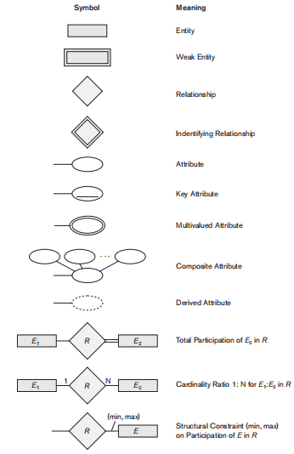
Notations for ER Diagram :

Slide 64
ER - Diagram

Slide 65
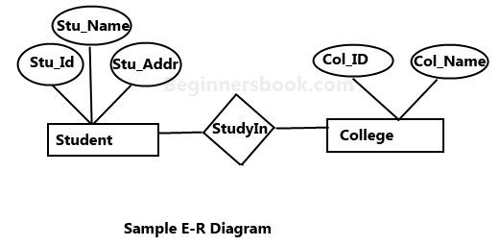
Entity–relationship model (ER model) : It describes the structure of a database with the help of a diagram, which is known as Entity Relationship Diagram (ER Diagram).
An ER model is a design or blueprint of a database that can later be implemented as a database.
The main components of E-R model are: entity set and relationship set.

Slide 66
Notations and their meaning in an E-R Diagram:
Rectangle: Represents Entity sets.
Ellipses: Attributes
Diamonds: Relationship Set
Lines: They link attributes to Entity Sets and Entity sets to Relationship Set
Double Ellipses: Multivalued Attributes
Dashed Ellipses: Derived Attributes
Double Rectangles: Weak Entity Sets
Double Lines: Total participation of an entity in a relationship set.

Slide 67
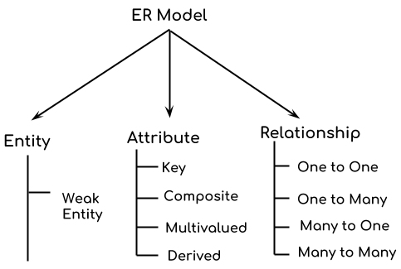
Components of ER Diagram

Slide 68
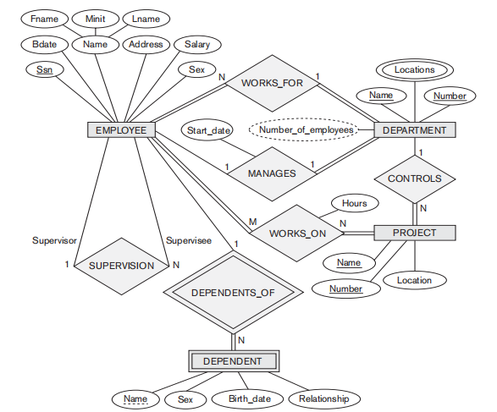
Example : ER diagram for Company Database

Slide 69
E-R Diagrams:
Employee Database
Car Database
Movie Database
Faculty Database
Project Database
Hospital Database
Railway System database
Airlines Database
Travel management System
Library Management System
Blood Donation Database
Hotel management System etc.,

Slide 70


